Slide 1
DEEP LEARNING CA1 PART A: CONVOLUTIONAL NEURAL NETWORK
By: Yek Yi Wei (p2107631)
Diploma in Applied AI & Analytics

Slide 2
Background Research
Clothing images all over the internet are found in online shopping, Instagram and Facebook photos, clothing catalogues, and blogs
These images of clothes are great factors in driving the clothing industry and economy today
The trends found in the current fashion style drive advertisement and sales in the online economy.
Clothes cataloging is essential in clothing sites, online shopping, and clothing productions to keep track and organize products in inventory
through the advancement in computing technology, convolutional networks, image recognition, and image detection have dramatically improved

Slide 3
CONVOLUTIONAL NEURAL NETWORK (CNN)
The convolutional layer, pooling layer, and fully-connected layer, are the three main types of layers stacked together to form a CNN architecture
convolutional layer-array of weights known as filters convolves through the input image multiplying each value in the filter to all the original pixel values of the image
pooling layer - reduce the spatial size of the representation & reduce the amount of parameters and computation in order to control overfitting.
fully-connected layer- gathers the output from the convolutional and pooling layer representing high-level features of the input image

Slide 4
Default Dataset
The Fashion MNIST dataset contains 70,000 grayscale images in 10 categories. The images show individual articles of clothing at low resolution (28 by 28 pixels)

Slide 5
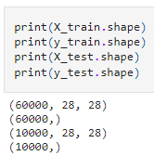
EDA
60,000 images in the training set and 1000 images, with each image represented as 28 x 28 pixels:
The labels are an array of integers, ranging from 0 to 9. These correspond to the class of clothing the image represents

Slide 6
EDA
DATA PREPROCESSING
inspect the first image in the training set, the pixel values fall in the range of 0 to 255

Slide 7
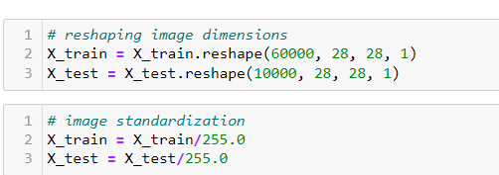
DATA PREPROCESSING
Scaled the values to a range of 0 to 1 before feeding to the neural network model.
Divide the values by 255.
The training set and the testing set are preprocessed in the same way

Slide 8
Data preparation/Features engineering
Verify that the data is in the correct format to build and train the network
Display the 25 random images from the training set and display the class name below each image.

Slide 9
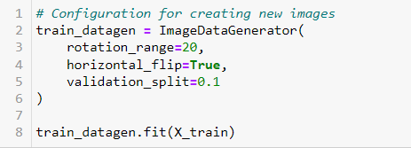
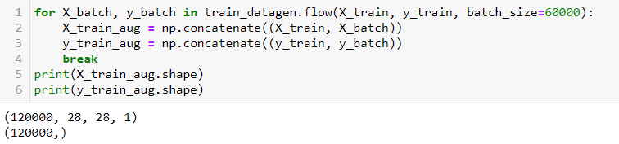
DATA AUGMENTATION
Rotation- The images are rotated randomly from 0-20 degrees
Horizontal flip - The images are flipped horizontally
Validation split - Fraction of images reserved for validation
Adding the Augmented Data to the default data
- Number of Rows x 2

Slide 10
Training Process- Refer to code
Plot accuracy on the training and validation datasets over training epochs.
Plot loss on the training and validation datasets over training epochs.
Early Stopping function - a callback that allows you to specify the performance measure to monitor, the trigger, and once triggered, it will stop the training process.
Define CNN Model
Define loss, optimizer, learning rate, metrics

Slide 11
Model Evaluation – Baseline Model
Val loss: 0.602
Val accuracy: 0.918
Evaluation of the accuracy of the trained model was done through batch evaluation test.
train loss is reducing as epoch increase, stabilize after epoch 20
Validation loss is increasing as epoch increased
overfitting
higher value of epoch mainly more than 10 are giving better accuracy
Validation accuracy not increasing as epoch increased
Big gap indicate overfitting

Slide 12
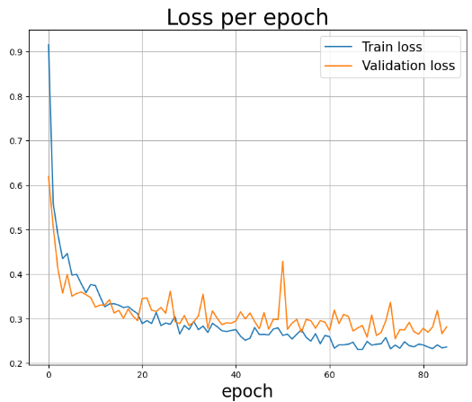
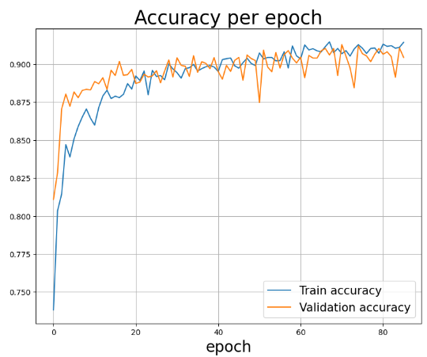
Model Evaluation – Baseline Model (With data augmentation)
Val loss: 0.262
Val accuracy: 0.913
Evaluation of the accuracy of the trained model was done through batch evaluation test.
The train and validation curves are improving
Overfitting has been improved
The validation loss stays lower than training loss longer than baseline model.
Training accuracy is slightly higher than validation accuracy indicating the overfitting has been improved

Slide 13
Improved Model1
Val loss: 0.2154
Val accuracy: 0.9326
Added more layers and added droupout to decrease the overfitting
The train and validation curves are improving
Overfitting has been improved
The validation loss stays lower than training loss longer than baseline model.
Training accuracy is slightly higher than validation accuracy indicating the overfitting has been improved

Slide 14
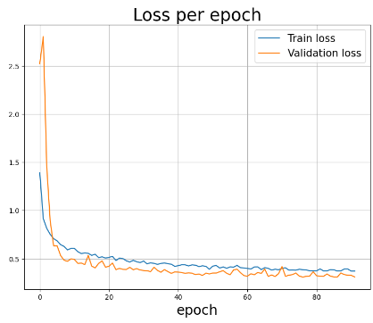
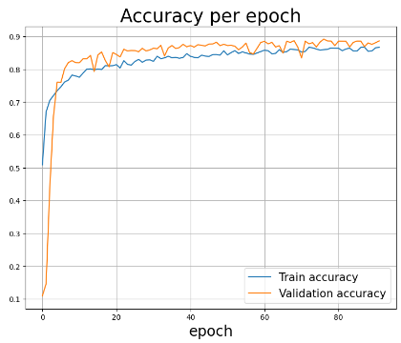
Improved Model1 (With data augmentation)
Val loss: 0.309
Val accuracy: 0.892
Even though the data train and validation curves improved, the validation loss and accuracy are quite bad
The train and validation curves are improving
Overfitting has been improved
The validation loss stays lower than training loss longer than baseline model.
Training accuracy is slightly higher than validation accuracy indicating the overfitting has been improved

Slide 15
Improved Model2
Val loss: 0.2140
Val accuracy: 0.9406
Added more layers and added droupout to decrease the overfitting
The train and validation curves are closer
No overfitting
Training accuracy and validation accuracy getting closer

Slide 16
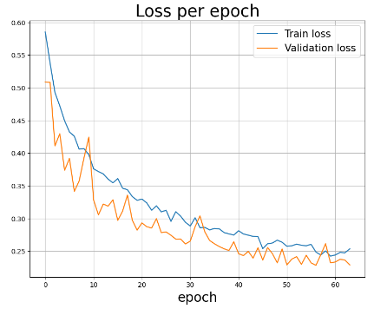
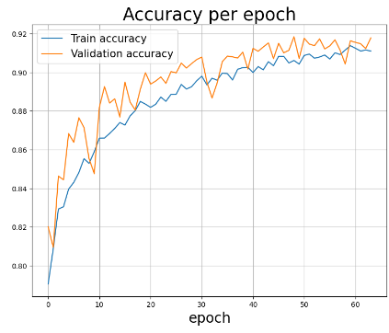
Improved Model 2 (With data augmentation)
Val loss: 0.326
Val accuracy: 0.887
Even though the data train and validation curves improved, the validation loss and accuracy are quite bad
The train and validation curves are closer
No overfitting
Training accuracy and validation accuracy getting closer

Slide 17
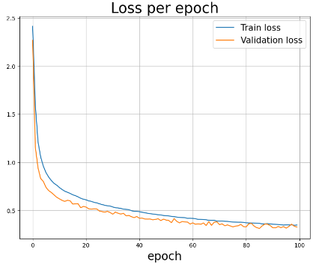
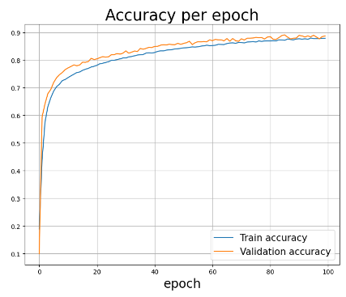
Improved Model 3
Val loss: 0.326
Val accuracy: 0.887
Changed the keras optimizer to SGD
The train and validation curves are closer
No overfitting
Training accuracy and validation accuracy getting closer

Slide 18
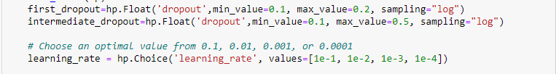
Hypertuned Improved Model 2
Hyperparameter Search (Keras Tuner: Random Search)
Parameters input dropout to between 0.1 and 0.2 because dropping the input data can adversely affect the training.
Parameters intermediate dropout to 0.5 and below because 0.5 is not ideal for small datasets and >0.5 is not advised it may cull more connections without boosting the regularization.

Slide 19
Hypertuned Improver Model 2
Val loss: 0.3801
Val accuracy: 0.9387
Hyperparameter Search (Keras Tuner: Hyperband)
Large gap between training loss and validation loss
Increasing of validation loss indicates Overfitting
Large gap between training accuracy and validation accuracy
Training accuracy higher than validation accuracy indicating overfitting

Slide 20
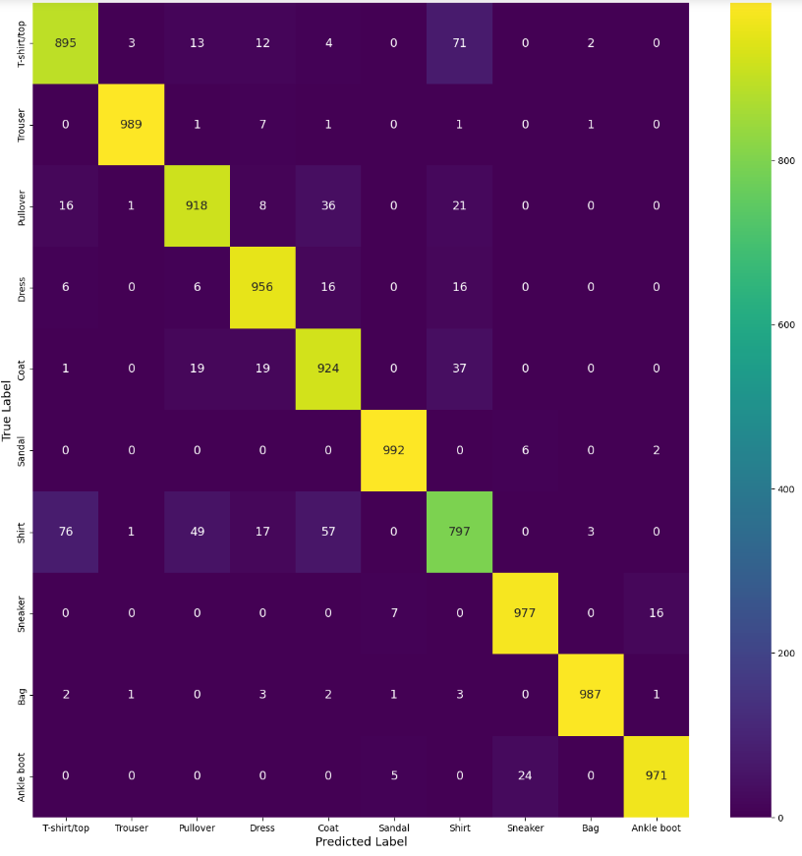
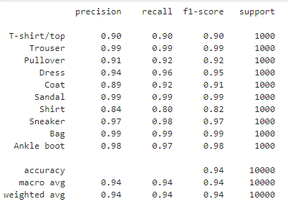
Performance Evaluation-Improved Model 2

Slide 21
Performance Evaluation-Improved Model 2

Slide 22
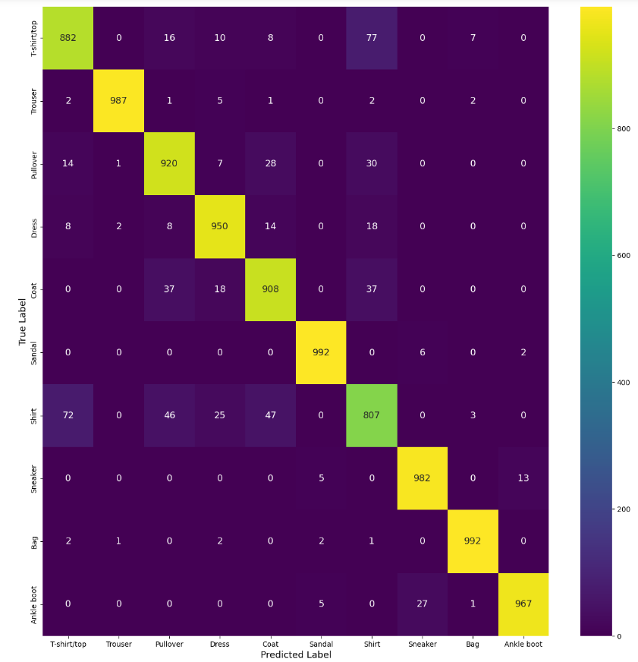
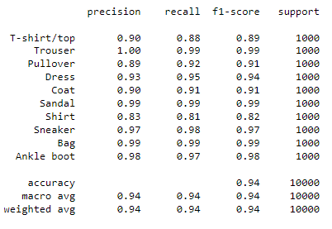
Performance Evaluation- Improved Model 2 AFTER Hypertuning

Slide 23
Conclusion-Data Augmentation
Model | Validation Loss | Validation Accuracy
Baseline model Aug | 0.262 | 0.913
Improved Model1 Aug | 0.309 | 0.892
Improved Model2 Aug | 0.326 | 0.887
The Data Augmentation is not so useful in the Fashion MNIST dataset as the validation accuracy is low and the validation loss is high.
- Due to each image is standard for each class ( for example: all the shoes are pointing the right, so it will just mess up the data even further.)

Slide 24
Conclusion on Model Improvement
Model | Validation Loss | Validation Accuracy
Baseline model | 0.6022 | 0.9184
Improved Model1 | 0.2155 | 0.9326
Improved Model2 | 0.2140 | 0.9406
Hypertuned Model | 0.3801 | 0.9387
Improved Model2 is the best performance model in this study since it has the
minimum validation loss of 21.4% with
highest accuracy 94.06%.

